Slide 1



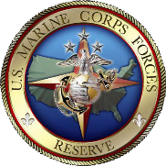
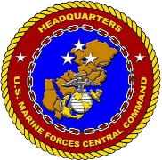









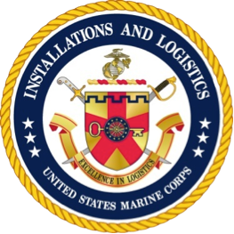

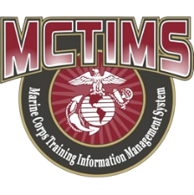







Marine Corps Task List
Mission Essential Task List
MCTL / MET / METL
Life Cycle Development
MAR 2025
HQMC CD&I
Capabilities Development Directorate
Total Force Structure Division
MCTL Branch

Slide 2
Overview
MCTL Branch Mission = Life Cycle Authoritative “Data Driven” Deliverables
Mission Planning, Requirements, MET-based Capabilities, Force Readiness
METs within the DoD Planning, Programming, Budgeting & Execution (PPBE) Process
MCT-to-MET-to Joint Staff MET Alignments
MCTL: The Dictionary of Current Capabilities; MET Building Blocks
CD&I’s Policies and Processes Alignments = MCT-to-MET/METL Workshop Process Deliverables:
  Mission Statement; MET standards Development (“Baseline/Advanced” Capability Statements; Manning/Training/Equipment and Outputs)
MET-to-Training and T&R Manual Alignments, New MCT or Change Recommendations
MET Standards Development Examples, Authoritative Data Source (ADS) System Repositories, Product Staffing, Approvals, Validation
MET/METL Products Development – What is involvedupport to Global Force Management (GFM) Process, Institutional Readiness WG (IRWG) and Quarterly Readiness Brief to CMC (QRB)
MCTL/MET/METL Life Cycle Products Info and POCs and Detailed Backups

Slide 3
CD&I / CDD
Total Force Structure Division
MCTL Branch Mission
DIRLAUTH per MCO 3500.26B (MCTL)
For development of defined content of capabilities/actions/activities expressed as Marine Corps Tasks (MCTs) resident within the Marine Corps Task List (MCTL) and Service Authoritative Database Source (ADS) System MCTIMS interfacing data to DRRS.
For ensuring MCTs are doctrine-based, provide accurate definitions, and represent all elements of the MAGTF.
DIRLAUTH per MCO 3500.110 (METL Development) (MAJOR REVISION 2023-2025)
Codifies Mission-Essential Task/Task List (MET/METL) and associated man/train/equip standards and outputs data development process.
Data represents “as-is” Current Force capabilities; used to develop “to-be” Future Force capabilities.
MET development includes criteria and scale to produce standards to achieve capability outputs assessed for mission support required for MET-based readiness reporting.

Slide 4
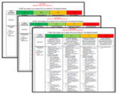




MCT / MET / METL Integrated Life Cycle
CURRENT Force Capability Requirements: Core/OPLAN/Assigned Mission
FUTURE Capabilities: Future Force Design
Current Deployable and Ready Mission Forces METs/METLs
USMC READINESS
DRRS Enterprise
MCTL “Tasks” = METs / METLs (MCTIMS)
Structure = Mission Statement/T/O&E (TFSMS)
Training = T&R Manual (MCTIMS)
Baseline/Advanced Performance Standards
Man / Train / Equip / Output
USMC Missions
Requirements
Capability Development Structure & Resources
Education
POIs
Training
RFFs / RFCs – Force Sourcing of Established USMC Current Capabilities
Mission Readiness Assessments
“Ready Force”
Mission Planning + Requirements + Capabilities + Resources =
Sourcing the Force and Reporting FMF Readiness in DRRS

Slide 5
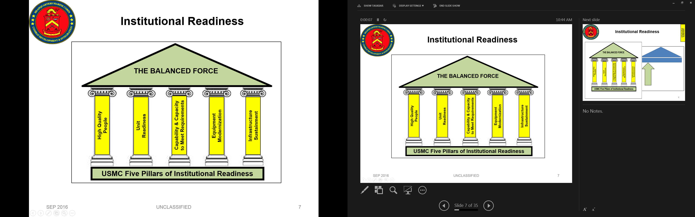
MCTs/METs/METLs, Capability Development Processes and PPBE**
NSS
NDS
39th CMC CPG
Operating & Functional Concepts
CURRENT METs/METLs
FUTURE METs/METLs
DPG
NMS
Force Development & Integration Strategic Plan
Approved P&R Assessment
QDR
GOALS:
--Ensure “CURRENT” capabilities (“METS”), supports “FUTURE” concepts and capabilities planning; ensure requirements development cycle produces feasible man/train/equip resources to achieve mission.
--Identify capability deltas, gaps and identify solutions via DOTMLPF process and Future Force capability development initiatives to improve FMF METs and associated standards, or, that aids in developing “Future” MCTs/METs.
Force Design Annual Report (FDAP)
P&R
(PA&E)
FY-30+
PB-25
Guidance
CD&I / CDD, OAD and MCWL
Assessment
End of FY
Force Design
METs / METLs
DRRS-MC
MCCL
MAGTF Wargames
OPFOR / SE
Execution
MCGL
POM-27
CD&I / CDD
PB-25
MCSDD
Planning
Front End Assessment
MCCIP
CD&I / CDD (TFSD)
CD&I “PLAN”
Program Reviews
Budgeting
Programming
= MROC
POM
POM-27
= Document
FY-26
P&R
MARCORSYSCOM
= Transition
P&R
Inside=Output; Outside=Input
**“Accelerate and streamline our modernization…Simultaneously, our ability to rapidly respond to Global crises must be maintained.”
Gen.Eric M. Smith, 39th CMC (2023)

Slide 6
MCT / MET Alignments/Linkages
JMETs/JMETL
Reported in DRRS-S (DoD / JS / OSD / Chairman’s Readiness System)
Links to Service Components METs/METLs
Supported
COCOM/CCDR
USMC METL
MARFOR
SN 5.3.5.3.1 Provide Forces – OPLANs/CONPLANs (UJTL)
“Tasks”/METs link
Top Down / Bottom Up
ISO HHQ, COCOMs Reported in DRRS
MEF/MEU/MEB
Marine Division
MCT 1.1.2 Provide Task Organized Forces
MCT 1.6.4 Conduct Defensive Ops
Infantry Regt HQ
MCT 5.7.4 Plan and Direct Defensive Ops
Infantry BN
(SPMAGTF)
(AA Teams)
MCT 1.6.4 Conduct Defensive Ops
Installations / Bases / Stations METLs provide Supporting Establishment Infrastructure and Support Programs
MCT 2.11 Maintain Multi-Domain Awareness
MCT 4.6.2.4 Provide Communications/Information Technology
MCT 4.6.6 Provide Community Services
MCT 4.6.7 Provide Installation Command & Staff Support Services
MCT 4.6.8 Provide Installation Aviation Operations Support Services
MCT 4.6.9 Provide Installation Ranges and Training Areas
MCT 4.6.10 Provide Installation Logistics Support Services
MCT 4.6.11 Provide Installation Protection Support Services
MCT 4.9 Provide Base and Station Facilities and Related Infrastructure
MCT 4.9.12 Provide the Installation Communication Grid (ICG)
MCT 5.3.2.1.1 Establish Base OPS Center to Plan, Coordinate, Communicate and Execute Installation Support to National Response Plans
MCICOM Regions
--MCIWest (I MEF)
--MCIEast (II MEF)
--MCIPac (III MEF)

Slide 7

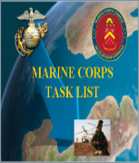
MCTL Supports Current Capability
MET/METL Development
MCTL: “Dictionary” of current USMC activities/actions/capabilities defined as “Tasks” that an organization must perform to accomplish a mission.
  MCT’s are used by COI / SE as “Building Blocks” for METs/METLs
MCTs are Organized by the Six (6) Warfighting Functions (WFF):
  Maneuver
  Intelligence
  Fires
  Logistics
  Command and Control
  Force Protection
  Information*
Contains Task Title, Task Definition, Doctrinal Ref and Suggested Measures of Performance
*NEW Warfighting Function
USMC TASKS:
MCT 1.6.1 Conduct Offensive Ops
MCT 1.6.4 Conduct Defensive Ops
MCT 1.10 Conduct Crisis Response
MCT 1.12 Conduct Expeditionary Ops
MCT 1.13.2 Conduct NEO
MCT 1.15.1.2 Facilitate Foreign HA
1. MCT 1.6.1 Conduct Offensive Ops
MCT 1.6.4 Conduct Defensive Ops
MCT 1.10 Conduct Crisis Response
MCT 1.12 Conduct Expeditionary Ops
MCT 1.13.2 Conduct NEO**
MCT 1.15.1.2 Facilitate Foreign HA**
**Not deemed CORE by Community but could be CORE+ for
Assigned Mission / OPLAN METL
Official Tri-Service Directive
OPNAVINST 3500.38C
MCO 3500.26B
USCG COMDTINST 3500.1C
Revised 16 Aug 2018
EX: INFANTRY CORE METL
TASK (MET)
TASK (MET)
TASK (MET)
1
2
3
TASK (MET)
TASK (MET)
TASK (MET)
4
5
6
FMF/Units DRRS Report – 30 Day Interval
SE/Installations DRRS Report - Quarterly

Slide 8
MCTL – What is a Marine Corps Task?
  “Tasks” describe capabilities / actions / activities
  a Unit or Organization must perform to accomplish the mission
        1. Maneuver
        2. Intelligence
        3. Fires
        4. Logistics
        5. Command and Control
        6. Force Protection
        7. Information
Contains Task Title, Task Definition, Doctrinal References and Suggested Measures
EXAMPLE Marine Corps Task
Task Title: MCT 1.12.1 Conduct Amphibious Operations
Definition: To conduct a military operation launched from the sea by an amphibious force, embarked in ships or craft with the primary purpose of introducing a landing force ashore to accomplish the assigned mission. Types of amphibious operations include assaults, withdrawals, demonstrations, raids, and other amphibious operations in a permissive, uncertain, or hostile environment.
Doctrinal References: (JP 1-02, 3-02, MCDP 1-0, 3, MCWP 3-33.7, 4-11.8, MCRP 3-33.7A, MCO 3104.1)
Suggested/EXAMPLE Measures:
M1 Percent Of qualified and deployable MOS Marines available to conduct Amphibious Operations.
M2 Percent Of Mission Essential Equipment (MEE) supply on hand and Mission Ready.
M3 Y/N Able to conduct amphibious ops at MEB level, transitioning MAGTF capabilities ashore from amphib shipping
M4 Y/N Regimental HQ capable of executing C2 throughout all phases of the amphibious operation.
Designed Capabilities of a USMC Unit
or
Functional Support Capabilities of an Installation / Base / Station
Six Warfighting Functions
Notes:
8

Slide 9
MCTs Become Unit METs
MCT
MCT
MCTL: Common reference guide used by USMC commanders, mission planners and unit trainers.
Units derive their “tasks” from MCTL per requirement to report their capability readiness via the MET-based construct within SECDEF Defense Readiness Reporting System (DRRS).
MCTL “Essential/Critical” MCTs for mission accomplishment become Mission Essential Tasks (METs) that align to the COI’s T&R Manual.
Core METs
  Critical, discrete, externally-focused activities that enable execution of the organizational mission; tasks for which standing organizations were designed; standardized for each unit type
Core Plus METs
  Have lower probability of execution; theater specific; NOT included in unit readiness assessments; Units may elect to include Core Plus tasks in their METLs and associated training plans
Assigned/OPLAN METs
  Developed and assessed when 25% or more of a unit deploys or prepares to deploy ISO a Named Operation; Based on Core METs, Core Plus METs, Mission templates, and deployment guidance
Standards: Baseline/Advanced Capability Statements, Personnel, Equipment, Training/E-coded Events/Exercises, Outputs.
MCT
MCT
MCT
MCT
Baseline/Advanced
Readiness Standards
Personnel
Training
Equipment
Exercises
Outputs
Subordinate/Supporting Units
Unit METL
Core Mission
Assigned Mission
Mission Statement
MET
MET
MET
MET
MET
MET
DRRS

Slide 10
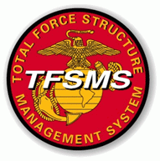


MET / METL Review Workshops Process
(MCO 3500.110**)
**2023-2025 MCO Revision: Modifies 2011 MCO language to address changing roles/responsibilities, required METL development support, and evolving training and readiness reporting advancements.
Policy validating integration between CD&I, TECOM, Stakeholder and FMF community to review/revise/recommend METs and standards to satisfy mission requirements.
MSG via NIPR DON-ETMS2 and/or TEAMS invite announces review requirements:
Mission Statement: Ensure organizational capability and mission intent can be met.
(Be prepared to submit update recommendations if needed.)
Marine Corps Tasks (MCTs): Do defined actions/activities/capabilities continue to satisfy the organizational mission intent and requirement?
(Be prepared to make MCT refinements/modifications if required.)
T/O&E: Personnel / Equipment data, resident within TFSMS, aligns to METs/METL.
(*T/O&E discrepancies are facilitated via TOECR process coordinated with COI Principal Advisor and CD&I Total Force Structure Division)
T&R Manual: Determine training components/standards, training events.
(Be prepared to make NEW training requirement recommendations.)
Record of Proceedings (ROP): Captures COI AO attendance and recommendations
Plans, Policies,
& Operations

Slide 11
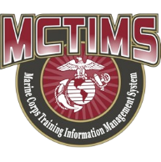

CD&I’s Policy Alignments:
MCTL (MCO 3500.26)
MET / METL Development (MCO 3500.110)
Total Force Structure Process (MCO 5311.1E)
MET/METL Development: Supports mission planning, training and T&R Manual review and development processes. Coordinated process involving CD&I, Principal Advisor/Stakeholder, PP&O and TECOM.
Aligns to…
Mission Statement & T/O&E Validation: CD&I’s Total Force Structure process where Unit/COI defined organizational capability and mission intent is expressed via Mission Statement within TFSMS. Unit METs/METL aligns to defined Mission Statement, available personnel and equipment.
Aligns to…
TECOM’s T&R Manual & TMT Reviews: TECOM training processes that identifies MET-based training component requirements, necessary event chaining and exercise synchronizations, POI and curriculum refinement and development.
Supports…
PP&O’s GFM Processes and FMF / SE Readiness Reporting Requirements ISO DOD/Chairman’s Defense Readiness Reporting System (DRRS).
Plans, Policies,
& Operations

Slide 12
MCT / MET / METL Development
Physical or Virtual MET / METL
Review Workshop Deliverables–Mission Statements
Mission Statements define capabilities (core competencies or operational requirements) for the Marine Corps IAW MCO 5311.1E Total Force Structure Process.
Mission Statements describe the organization, mission and tasks, concepts of organization and employment, administrative and logistics capabilities, and command and signal.
Review current unit Mission Statement to ensure alignment to chosen Core METs, or recommend revision for updating.
Mission Statement revision requires completion of the specific package of documents for presentation/approval by the community Principal Advisor, and submission to CD&I Total Force Structure Division for approval by DC CD&I.
Principal Advisors are responsible for creation, review, modification, formal staffing and General Officer endorsement of proposed final copy.
  Ensures every unit identified by a UIC has a current Mission Statement.
  Ensures review of Mission Statements is conducted every three (3) years.
  Ensures community METs are aligned with their appropriate unit’s Mission Statement.
Mission Statement updates have three (3) months from date developed/revised unit METs are incorporated and published within MCTIMS.
12

Slide 13
MCT / MET / METL Development
Physical or Virtual MET / METL Review
Workshop Deliverables - Mission Statement
Units without valid current Mission Statements run the risk of not having submitted TOECR’s considered. Mission Statements are required to validate requested changes.
The community’s Principal Advisor shall electronically staff the endorsed unsigned Mission Statements to DC CD&I (TFSD) for final administrative review and submission to CMC (DC CD&I) for final approval.
MCO 5311.1E Total Force Structure Process, Appendix B, provides example of the Mission Statement Format/package necessary to facilitate change. Format contains:
  Header (i.e., Department of the Navy, HQ USMC, 3300 Russell Rd, Quantico VA 22134)
  UIC or Multiple UICs/Organization Name (Unit Identification Code-M21810 2nd Assault Amphibian BN)
  Promulgation Statement (Briefly outline the organization and content of the continuity of operations plan and describe what it is, who it affects, and the circumstances under which it should be executed.)
  Organization (i.e., HQ & Service Co.; A Company; Engineer Support Co.)
  Mission/Tasks (i.e., MCT 1.1.2 Provide Task-Organized Forces; MCT 1.6.1 Conduct Offensive Operations; etc.)
  Concept of Organization (Briefly explain the unit’s organization and reporting heirarchy. (Who the unit reports to)
  Concept of Employment (i.e., 6 warfighting functions)
  Admin Capabilities (i.e., How the unit’s administration is carried out and to what extent)
  Logistics Capabilities (i.e., 7 functions of logistics)
  Command and Signal (Briefly explain who the commander of this unit reports to and capability it provides).
  Supersession (Ex: This Mission Statement supersedes the previous Mission Statement and is effective upon receipt)
13

Slide 14
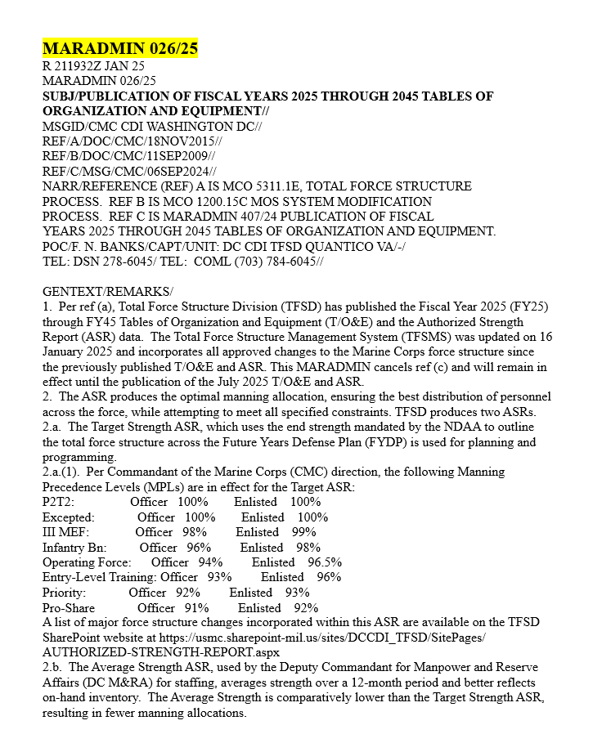
Table of Organization and Equipment
Change Request (TOECR) Process
“8.a. All TOECRs submitted for inclusion in the July 2025 Authorized Strength Report (ASR) must be submitted to TFSD NLT Wed, 21 May 2025.”
TOECR Submissions should be directed to the TFSD Branch Heads representing the MAGTF Elements: CE, GCE, LCE, ACE, Navy, and Supporting Establishment (SE)

Slide 15
CD&I TFSD Branch Heads
MCTL/METL – Maryroi Goldman, Branch Head, 703-432-8460, maryroi.goldman@usmc.mil
  Mario Martinez, 703-784-6240; James Martin 703-784-6046; Mike Aguirre 703-784-6085
CD&I TFSD POCs for each MAGTF community (Mission Statement, Structure (T/O&E)) :
    CE – Anthony McClendon, Branch Head, 703-784-4710, Anthony.mcclendon@usmc.mil
      Ramon Sanchez, 703-784-5720
    GCE – Maj. Cory Moyer, Branch Head, 703-784-6278, cory.moyer@usmc.mil
      Tom Gilbert, 703-784-6237
    LCE – LtCol. Dell Robinson, Branch Head, 703-784-6797, dell.Robinson@usmc.mil
      MSgt. Ashley Wrenn, 703-784-6254
    ACE – [Checks in Jun 2025], Branch Head, 703-784-6241, email: ____________
      MGySgt. Joseph Smith, 703-784-4913, joseph.d.smith@usmc.mil
    SUPPORTING ESTABLISHMENT – Ms. Marsha Harris, Branch Head, 703-784-6079,
    marsha.harris@usmc.mil, Steve Rhodes, 703-432-8000
    RESERVE – LtCol.Scott Pabst, Branch Head, 703-784-6045, scott.pabst@usmc.mil
      MSgt. Christopher Stagg, 703-432-8032
    NAVY – Jason Darby, Branch Head, 703-432-8327, Jason.darby1@usmc.mil
      LCDR Daniel Brown, 703-432-8347
Current METs/METLs within the MCTIMS Task Master database via:
    https://mctims.usmc.mil/tnrmanual/taskmaster/pages/home.aspx
Current Total Force Structure Management System (TFSMS) data (i.e., T/O&E) via:
    https://tfsms.mceits.usmc.mil/TFSMSPortal/faces/Home

Slide 16
MCT/MET/METL and
T&R Development Process
Adapting to Future Force Design and Modernization
MARADMIN 418/24 – FY25 Schedule of MET/METL, T&R Manual & TMT Reviews
“Ensuring METs/METLs development, refinement and alignment actions are synchronized with unit mission statements, T&R manuals and aligned T&R training events ISO service capabilities.”
Established “Current” MCT / MET / METL / Training Development Process:
A unit’s mission requirement; What capabilities can the unit provide NOW?
What MET-aligned e-coded training events/exercises are conducted NOW?
“Future” MCT / MET / METL / Training Development Supporting Process:
Concept derived DRAFT MCTs/METs developed::
  Requires Service validation to quantify TTPs and curriculum development.
  Requires available doctrine (i.e., Joint, USMC or other Service).
  May NOT have existing/aligned curriculum, POI, training standards, or T&R events.
  Requires experimentation and training exercises IOT determine MET-to-training feasibility.
  Are NOT officially published/available within MCTL / MCTIMS / DRRS.
“Future METs”, will be incorporated within MCTL as “DRAFT, or, T-MCTs” for use in MCTIMS training modules to aid in training experimentation. Once approved, can be used as readiness reportable METs for the unit and aligned to the T&R Manual.

Slide 17
MCT / MET / METL Development
Improved Coordination: MCWL
Establishment Goal: To adopt an agreed methodology wherein concept development, wargaming and scenario experimentation information conducted by MCWL’s Future Force initiatives is integrated or made visible to the MET/METL and training development processes.
Objective: Would ensure NEW Future Force structure, unit repurposing and/or evolving unit formations factor “current” capability data injects (man/train/equip standards) that the MET/METL/T&R Manual processes develop and maintain.
Doctrine alignments or development considerations necessary to validate future TTPs and academics development.
Concepts, once approved by Senior leadership, could provide source docs (i.e., TMEABO) to aid, guide and inform MCT/MET capability and associated training development.
Mission Statement development, ICW CDD/TFSD and Principal Advisor community stakeholder, aligns to new MCTs/METs.
Identification of required MOSs within new/repurposed formation required to perform future formation METs (i.e., T/O-to-MET, T/E-to-MET, and Training standards-to-MET)
  Will the new unit formation require MOS recruitment, MOS refinement or will repurposing a unit require coordination between M&RA and TECOM?
  What training curriculum or Formal School POIs will be required for future force formations?
  Will new unit formations have the necessary materiel, equipment or gear available within an established timeline to ensure adequate training, experimentation, simulation or physical range and field exercises associated to the future formation MET?

Slide 18
NEW or Revised MCT Recommendations
REVISED MCT 3.2.3.1.2.1 Conduct Strike Strike operations damage or destroy an enemys objective or capability. Strike operations include both air interdiction and attack operations. Air interdiction is an air operation conducted to divert, disrupt, delay, or destroy the enemy’s military surface capabilities before it can be brought to bear effectively against friendly forces, or to otherwise achieve enemy objectives that are conducted at such distances from friendly forces that detailed integration of each air mission with the fire and movement of friendly forces is not required. Attack operations include offensive action by any part of the joint force in support of the Offensive Counterair (OCA) mission against targets which contribute to the enemys air and missile capabilities. JP 1, 0-2, 3-0, 3-01, 3-03, 3-09, 3-30, 3-31, MCWP 3-2, NDP 1, NWP 3 FORMER MCT TITLE/DEFINITION MCT 3.2.3.1.2.1 Conduct Air Interdiction Air interdiction operations destroy, neutralize, or delay the enemy's military potential. This type of operation is a response to a known target that is briefed in advance. Air interdiction is normally part of the JFC campaign.
  MEU OAG
NEW
MCT 1.12.8 Establish and Operate Expeditionary Advanced Bases
To seize or occupy, establish, operate, sustain, and disestablish one or more expeditionary sites in support of naval operations, to include, but not limited to, ports, airfields, FARPs, forward operating bases, and firing areas. This task may include reducing pockets of resistance, establishing security, and operating the site(s) until the site is disestablished or control is transferred to another organization.
JP 3-0, 3-10.1, 3-18, MCDP 1-0, MCDP 3; MCWP 3-2, 3-32
Requires METL Review WG provide:
Described capability, actions, activities
Doctrinal support (USMC, Joint, Other Service)
Rationale of Task to meet HHQ guidance, mission statement and mission requirements
Ensure Task is aligned to necessary training and T&R Manual alignments or modifications.
Crosswalked. Does the MCT revision potentially affect another COI that may be also using it as a MET for their DRRS report?
  AVN METL Review Feb 2019

Slide 19
MET/METL/Training Review
(Physical or Virtual)
Products Development
The list of current METs requiring integrated review. MET refinements/recommendations should be based upon ongoing unit shaping actions.
Main or Community breakout WG leads address and review:
  Current Marine Corps Tasks (MCTs) definitions used as METs
    Are MCT actions/activities/capabilities expressed and defined still accurate?
  Current Baseline and Advanced MET capability statements
  Current Output standards
  Current Training standards
    Are the training events adequate or require refinement?
    Does unit need additional individual, collective or chained training events?
    Recommendations for integrated staff training events and exercises?
    Are there Certification requirements and MCCRE considerations?
  Current MET-to-T/O alignments
    Critical MOS identified - necessary to execute the METs
  Current MET-to-T/E alignments
    Mission Essential Equipment (MEE/TAMCNs) - necessary to execute the METs
  Subordinate Crosswalk to HHQ (Identify supporting/subordinate unit necessary to achieve defined MET capability.)
  CBRN Training Assessment Crosswalk
  MET-to-Training – identify T&R Manual events Crosswalk
  **Develop Community “Challenges / Observations/ Issues” Slide (included in METL staffing pkgs. to provide SA/visibility to leadership).
  Identify Units of Employment (UE)* standards (if applicable to the organization)
  *UE: Level at which a unit generates forces for deployment, building blocks of
  standard task organization.

Slide 20
MET Standards
  The combination of measures and criteria used to illustrate minimum acceptable proficiency required in task performance.
  FOCUS: Develop standards consistent with capability intent and desired outputs.
Resource:
Manpower (T/O) and Equipment (T/E) required to produce the outputs
Training:
  Each MET should have standards for two (2) levels of trained proficiencies:
        Baseline Capability: Level of readiness expected from a USMC tactical unit, normally sustained through unit Core training at home station and achieved without requiring a Deployment for Training, dedicated at-sea training, or external MAGTF support.
        Advanced Capability: Level of readiness required by specific units expected to perform a critical role in a mission or OPLAN. This level of readiness normally requires external MAGTF support, ship-to-shore movement, or a Service-level or Joint training exercise. Units designated for training to this level are normally selected through the force synchronization process.
  METs align to COI T&R Manuals, individual/unit “E”-coded training events, and exercises/certifications necessary or required to accomplish proficiencies, produce desired outputs and provide trained capability assessments.
Subordinate/Supporting Unit:
Tasks performed by other units that are required to produce the outputs; Required for intermediate level commands

Slide 21
MCT / MET / METL Development
MET Baseline / Advanced Capability Statements
Per CJCSI 3401.02 Force Readiness Reporting
“Qualified Yes”: Unit can accomplish all or most tasks to standard under most conditions. Specific standards and conditions that cannot be met, as well as the shortfalls or issues impacts the unit’s inability to accomplish the task. Must be clearly detailed in MET assessment.
“Yes”: Unit can accomplish the task to established standards and conditions. The assessment should reflect demonstrated performance in training or operations.
  Challenge: What is “most”?
  Solution: USMC re-defined the assessment process to distinguish between baseline standards (equivalent to “most”) and advanced standards (equivalent to “all” established standards).
USMC DRRS
“Qualified Yes” = Baseline readiness: Level of readiness expected from a USMC tactical unit, normally sustained through unit core training at home station and achieved without requiring a Deployment for Training, dedicated at-sea training, or external support
“Yes” = Advanced readiness: Level of readiness required by specific units expected to perform a critical role in a mission or OPLAN. This level of readiness normally requires external support, ship-to-shore movement, or a Service-level or Joint training exercise. Units designated for training to this level are normally selected through the force synchronization process.
Considerations for Baseline:
Sustainment at Home Station
Sustained across most of a unit’s lifecycle
No external MAGTF support required (evaluators or attachments)
No dedicated at-sea training required
Considerations for Advanced:
Peer threat
Adversary force used for training
Degraded/denied C2 environment
Training with attachments (external MAGTF support)
Deployment for training (Arctic, Jungle, etc.)
Ship-to-shore movement / at-sea training (naval platforms or connectors)
Joint or Naval context
Complex terrain
Accelerated response timelines
Evaluated exercise or MCCRE
Example: MCT 1.6.1 Conduct Offensive Operations (INF BN)
Baseline Capability: Company-level maneuver to seize maritime terrain objectives in support of naval operations.
Outputs: Coordinated company attacks, destroy an enemy force, of company strength, in prepared defensive positions. Exercise C2 and signature management across all expeditionary sites. Employ aviation-delivered fires.
Advanced Capability: Synchronized company-level maneuver to seize maritime terrain objectives defended by a peer adversary, in complex terrain, in a contested and/or degraded command and control environment.
Outputs: Integrate naval and joint fires into the scheme of maneuver. Synchronized company-level maneuver in complex terrain. Prepared positions / complex obstacles. Explosive hazard / improvised threat environment. Contested / C2D2 environment. Externally evaluated live exercise with naval force participation and a peer enemy force within the last 12 months.

Slide 22
EXAMPLE: MLR Collective Baseline and Advanced Capability Statements
MCT 1.12.8.1 Conduct Expeditionary Advanced Base Operations (EABO)
  Baseline: Capable of establishing an expeditionary advanced base and enabling joint and naval campaigns during competition and conflict.
  Advanced: Capable of maneuvering and persisting inside a contested maritime environment through the establishment and displacement of multiple expeditionary advanced bases. Capability has been demonstrated in an externally evaluated simulated or live exercise with naval force participation.
MCT 3.2.7.5 Attack Maritime Targets​
  Baseline: Capable of attacking maritime surface targets.​
  Advanced: Capable of integrating naval, joint, and coalition fires against maritime targets from distributed elements in a contested DDIL environment.
MCT 3.2.8 Conduct Expeditionary Strike​
  Baseline: Capable of​ delivering and integrating organic multi-domain fires in support of Naval objectives.​
  Advanced: Capable of integrating organic and supporting fires in support of Naval and/ or Joint objectives.
MCT 5.14 Conduct Information​
  Baseline: Capable of planning, enabling, or employing capabilities that generate, preserve, deny, and project information in order to create and exploit information advantages (systems overmatch, prevailing narrative, and force resiliency) across the competition continuum in support of MAGTF and/or Naval operations.
  Advanced: Capable of conducting information activities for extended periods across distributed battlespace in order to generate, preserve, deny, and project information in a contested Naval or JIIM environment.

Slide 23
MET Personnel, Equipment, Output and Subordinate Standards
Determine Personnel required to produce the task outputs;
Link Personnel on the unit Table of Organization (T/O) to the tasks they support;
      Personnel Examples:
        >= 16 crews available and formed
        >= 80% Of entire T/O assigned billets filled with MOS-qualified, deployable personnel
Determine Equipment required to produce the task outputs;
Link Equipment on the unit Table of Equipment (T/E) to the tasks they support;
      Equipment Examples:
      >= 80% of the BN T/E systems mission ready and available
      >= 4 stand-alone XXX kits ready and available
Output Examples:
      >= 22,400 gallons per day of bulk fuel received/stored/dispensed
      >= 2 site(s) established to provide immediate Humanitarian Assistance (including food, water, and health services)
      Y/N Capable of boarding high freeboard ship
      Y/N Capable of applying combat power to delay, impede, halt, or dislodge the enemy
Subordinate Examples:
      >=2 Battalions report Yes/Qualified Yes for MCT 1.12.1 Conduct Amphibious Operations
      Y/N MAW can provide task-organized MAG capable of conducting MCT 1.3.4 Conduct Assault Support OPS
      Y/N MEF GCE reports DRRS Y/Q for the following tasks:
      MCT 1.6.4 Conduct Defensive Operations
      MCT 1.14 Conduct Stability Ops
Personnel, Equipment, Output and Subordinate unit standards are used in DRRS as
assessment metrics describing
resources required to produce capability endstates and achievable mission support.

Slide 24
T/O EXAMPLE: 3rd MLR LCT Critical MOS
Current LCT Critical MOS List
Critical MOS | RETAIN |  | Critical MOS | RETAIN
0202 | Yes |  | 0631 | Yes
0203 | Yes |  | 0802 | Yes
0231 | No |  | 0811 | No
0241 | Yes |  | 0847 | Yes
0261 | Yes |  | 0848 | Yes
0302 | No |  | 0861 | Yes
0311 | No |  | 0869 | Yes
0341 | Yes |  | 2602 | Yes
0352 | Yes |  | 2629 | Yes
0369 | Modify |  | 7316 | Yes
0411 | Yes |  | 7502 | Yes
0431 | No |  | 8621 | No
Critical MOS | DROP / RATIONALE
0231 | Not Critical MOS
0431 | Replaced with 0441
0811 | Replace with 0814
8621 | Not on TO
BLUF: Use Critical MOS list to highlight low density MOS that would be lost in the aggregate calculation but generates disproportionate effects if not filled.
Do not select critical MOSs that in total would represent over 50% of the unit, or, that represents a high volume in comparison to the other selected MOS.
Some units only have 3 MOS. In this case, all 3 must be selected; Some units have a higher density MOS with a historically low level of fill.
A new MOS, a problem MOS, etc., and other MOS don't matter or are not expected to be an issue. In this case it may be worth selecting the MOS in order to focus on the main issue.

Slide 25
MARADMIN 350/24 – Identification of Marine Corps Readiness Reportable Ground Equipment
Provides temporary policy guidance and eliminates the need for future Marine Corps Bulletin (MCBul) 3000 publications by DC, I&L.
Streamlines the process of Principle End Item (PEI) and Mission Essential Equipment (MEE) identification and designation.
DoD Defense Readiness Reporting System (DRRS) receives requirement information from TFSMS along with inventory and maintenance information from GCSS-MC to generate supply and materiel readiness assessments
Marine Corps will use the Table of Organization and Equipment Change Request (TOECR) process to update the materiel readiness reporting designation and classification of ground equipment.
Classification of equipment as MEE is specific to the type of unit and is inextricably linked to the unit’s Mission Essential Tasks (MET) that comprise the unit’s METL.
Determination of MEE will only be conducted via the MET/METL Development Process.
Stakeholders may submit requests for changes to a unit’s MEE as inputs to the respective MET/METL review and development workshops.
FMF MET/METL review and development workshop products, to include MET-to-MEE alignments, receive O6 and GO-level staffing, and are validated by CD&I Decision Memorandum. Once approved, TFSD will update TFSMS to reflect MEE changes. To ensure compliance with the Service's Readiness Reporting requirements, DC PP&O will be the final approving authority for METL-related MEE decisions.

Slide 26
T/E EXAMPLE: 3rd MLR Littoral Combat Team (LCT) MEE
TAMCN | Nomenclature
A00677G | AN/MRC-148
A01397G | AN/TRC-209 - Power amplified HF
A02047G | HHVDL (Replaces the Video Scout)
A01737G | COMMUNICATION SECURITY MODULE (CSM)
A01987G | AN/PRC-160 – HF
A02107G | MUOS Antenna (At the halt)
A02217G | GEOSPATIAL WORKSTATION
A02457G | MCWS-X (Replaces VSAT)
A03877G | NOTM POP
A80237G | AN/PYQ-10 (SKL)
B00607B | MEDIUM CRAWLER TRACTOR (MCT)
B00637B | TRAM
B00777B | Generator Set Diesel – 1030 5k
B00717B | LWPS
B01327B | ENFIRE
D00157K | MTVR WRECKER
SUAS ??
NMESIS ??
Starshield ??
New Equipment NOT fielded yet, issued, or on T/E should NOT be included as MEE
BLUF: Mission Essential Equipment (MEE) TAMCNs should be unique to each unit type, especially items that identify the unit (i.e., LAVs, Cannons, AAVs, Aircraft).
These should be major investments – low density - critical enablers to the unit's primary capability.
Essential and indispensable for the execution of the unit METs in support of a Combatant Commander.
Should also be items that have already been fielded (normally to an 85% level) across the affected unit type.

Slide 27
Identify Training Standards
(T&R Events Align to METs)
Training Standards
EX: Intel BN E-Coded Events
Measure the training required to produce the required Mission Essential Task (MET) outputs.
Link E-coded training events to METs.
Use current T&R Manual as the starting point.
*Community may identify NEW training component, event or CERTEX requirements for submittal and inclusion at the next T&R Manual review cycle.
EXAMPLE:
Y/N - BN trained to standard in the following E-coded events:
INTL-ANYS-4003 and INTL-ANYS-4001 chained events
>=4 Targeting Marines trained to standard in the following E-coded event: INTL-TRGT-4001
Y/N - 2 Teams are DoD Info Assurance Standard compliant (DODI 8570)
T&R Manual Aligned Training Events | MCT 1.1.2 Provide Task Organized Forces | MCT 2.1.1 Conduct Intel Functions | MCT 2.1.2.6 Conduct Counterintelligence | MCT 2.1.3.3 Conduct Human Intel Activities | MCT 2.2.4 Conduct Sensor OPS | MCT 5.1.1.7 Conduct Spec. Intel. Communications
INTL-FUNC-8901 | X | X
INTL-ANYS-4001 | X
INTL-ANYS-4003 | X
INTL-COLL-4001 |  | X
INTL-TRGT-4001 |  | X
CIH-CINT-3001 |  |  | X
CIH-HUMI-3001 |  |  |  | X
GRSO-PLAN-3001 |  |  |  |  | X
SIEW-OPS-3001 |  |  |  |  |  | X
Through the MET/METL Review Workshop process, Training requirements and developed Standards
are aligned and identified in COI T&R Manuals, various training Programs of Instruction, curriculum management.
Notes:
Measure the training required to produce the required task outputs under the selected task conditions
Link E-coded training events to METs
Use current T&R as the starting point (May identify new requirements for the next T&R cycle)

Slide 28
MET Subordinate Capability Crosswalk
Top-Down / Bottom-Up
MEU CORE METL (OCONUS MEUs)
MCT 1.12.1.2 Conduct Amphibious Raid
MCT 1.12.1.3 Conduct Amphibious Assault
MCT 1.12.1.8 Conduct Maritime Interception Operations (MIO)
MCT 1.12.8 Establish and Operate Expeditionary Advanced Bases
MCT 1.13.2 Conduct Noncombatant Evacuation Operations (NEO)
MCT 1.15.1.2 Facilitate Foreign Humanitarian Assistance (FHA)
MCT 3.2.8 Conduct Expeditionary Strike
MCT 5.5.1 Integrate and Operate with Joint, Interagency, Intergovernmental and Multinational (JIIM) Organizations
MCT 6.1.7 Conduct Embassy Reinforcement
MCT 6.2.1 Conduct Tactical Recovery of Aircraft and Personnel (TRAP)
MEU CE Core METL
MCT 1.8.3 Conduct Sensitive Site Exploitation 1, 2, 3
MCT 1.12.1.8 Conduct Maritime Interception Operations (MIO) 3
MCT 2.1 Plan and Direct Intelligence Operations 1, 2, 3, 4, 5, 6, 7, 9, 10
MCT 3.2.1.3 Integrate Fire Support with the Scheme of Maneuver 1, 2, 3, 4, 7, 10
MCT 4.11 Plan and Direct Logistics Operations 1, 2, 4, 5, 6, 9
MCT 5.5.1 Integrate and Operate with Joint, Interagency, Intergovernmental and Multinational (JIIM) Organizations 4, 5, 6, 8, 9, 10
MCT 5.7 Exercise Command and Control of Air and Ground Forces 1, 2, 3, 4, 5, 6, 7, 8, 9, 10
MCT 5.7.1 Plan and Direct Amphibious Operations 1, 2, 3, 4
MCT 5.14.9 Plan and Direct Operations in the Information Environment 1, 2, 3, 4, 5, 6, 7, 8, 9, 10

Slide 29
Community Issues/Concerns
EXAMPLE: 3rd MLR HQ Challenges
Recommendation: Training capability does not exist for the MLR to train and be evaluated within the LVC and is a shortfall for the MLR achieve advanced outputs. Enterprise needs to extend LVC capabilities, specifically resources invested (POM) to outfit garrison infrastructure and forward deployed assets to facilitate LVC objectives.
  OBSERVATION: Project Tripoli and the DOTMLPF WG need to examine LVC capabilities to support MLR resource requirements to support maritime domain awareness.
Recommendation: A revision needs to occur to have the AAC appropriately split between the two UIC reports as fed by GCSS-MC.
  OBSERVATION: Currently in DRRS the MLR HQ AAC is split between two reports the H&S UIC Report and the CommCo UIC Report. Almost all A TAMCN assets are assigned to the Comm Co UIC and therefore register as zero on hand which is a false negative for S-Rating.
MAR 2025-CUI
29

Slide 30
CBRN Training Assessment Criteria
(EX: 3rd MLR HQ)
Core METs | MET execution | Interval
Support Maritime Domain Awareness (MDA) | HQ plans for CBRN threats | 12 months
Plan and Direct Logistics Ops | HQ plans for CBRN threats | 12 months
Plan and Direct Operations in the IE | HQ plans for CBRN threats | 12 months
Conduct Interorganizational Cooperation | HQ plans for CBRN threats | 12 months
Command and Control Distributed Maritime Ops | HQ plans for CBRN threats | 12 months
Plan and Direct Littoral Maneuver | HQ plans for CBRN threats | 12 months
Plan and Direct Sea Denial Operations | HQ plans for CBRN threats | 12 months
This table provides a common framework for the CBRN MET calculation per MARADMIN 135/23 “INTERIM GUIDANCE FOR CHEMICAL, BIOLOGICAL, RADIOLOGICAL, AND NUCLEAR DEFENSE READINESS REPORTING, TRAINING, EQUIPPING, AND EXERCISE CERTIFICATION”
4.E.1. Reference B requires commanders to assess their units’ readiness to accomplish their missions in CBRN environments. This requires units to integrate relevant simulated CBRN environments into training and exercises. The baseline criteria for a simulated CBRN environment are planning for CBRN threats and reacting to CBRN incidents during a unit exercise. Scenarios will exercise units’ staff planning processes and individual and collective techniques, tactics, and procedures (TTP) to protect the unit and sustain operations. Where practical, commanders will request and incorporate CBRN response augments into scenarios.
4.E.3.A. Commanders will review their METL and identify which METs their units are realistically expected to execute in CBRN environments.
4.E.3.B. Commanders may request relief of MET training requirements from the first general officer in the chain of command or his delegate. If a waiver is granted, the commander will only assess CBRND readiness for the remaining METs.
4.E.3.C. Commanders must resubmit for relief of CBRND training requirements after 12-months.
4.E.3.D. Commanders relieved of all MET training requirements will not factor MET assessment into the unit T-level. Regardless of MET training requirements, commanders will still complete CBRND individual and team training.
4.E.3.E. Calculation: Number of METs assessed internally in a simulated CBRN environment as Qualified Yes (Q) or evaluated externally as Yes (Y) during an exercise (MCCRE, SLTE, CERTEX, ETC.) in the past 12 months divided by number of METs required to be trained for CBRN environments equals percent of CBRN capable METs. Commanders will not select T-1 unless all required METs are assessed as (Y) in a simulated CBRN environment.
MAR 2025-CUI
30

Slide 31
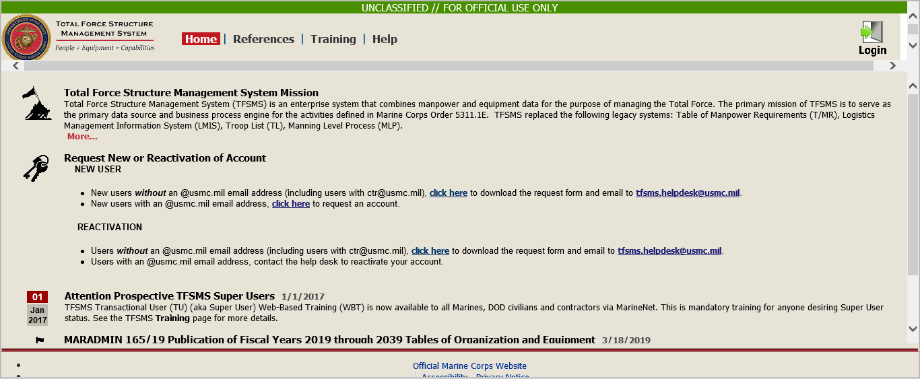
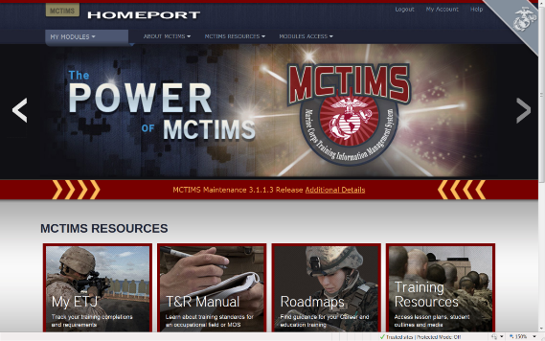
MET Data Alignments within
ADS Systems
Personnel Standards / T/O /Critical MOS
AAV BN T/O Critical MOS | MCT 1.1.2 Provide Forces | MCT 1.4.1.1 Conduct Breaching Operations | MCT 1.6.1 Conduct Offensive Operations | MCT 1.6.4 Conduct Defensive Operations | MCT 1.12.1 Conduct Amphibious Operations | MCT 5.3.2 Establish Means for Command and Control
1803 AAV Officer | X | X | X | X | X | X
2141 Amtrac Repair/Tech | X | X | X | X | X | X
2841 Systems Repairer | X | X | X | X | X | X
0621 Field Radio Operator | X | X | X | X | X | X
0651 Cybernet Ops | X |  |  |  |  | X
8404 Corpsman | X | X | X | X | X | X
Equipment Standards / T/E / MEE
MEE TAMCN | NOMEN-CLATURE | MCT 1.1.2 Provide Forces | MCT 1.4.1.1 Conduct Breaching Operations | MCT 1.6.1 Conduct Offensive Operations | MCT 1.6.4 Conduct Defensive Operations | MCT 1.12.1 Conduct Amphibious Operations | MCT 5.3.2 Establish Means to Command and Control
B1315 | Launcher, MK-154, MOD 1 |  | x
E0796 | AAV, C4, AAVC7A1 | x |  |  |  |  | x
E0846 | AAV, Personnel, AAVP7A1 | x | x | x | x | x | x
E0856 | AAV, Recovery, AAVR7A1 | x
Training Standards
TRAINING EVENTS | MCT 1.1.2 Provide Forces | MCT 1.4.1.1 Conduct Breaching Operations | MCT 1.6.1 Conduct Offensive Operations | MCT 1.6.4 Conduct Defensive Operations | MCT 1.12.1 Conduct Amphibious Operations | MCT 5.3.2 Establish Means to Command and Control
AAV-CSS-7002 Conduct Recovery and Evacuation Operations |  | X | X | X | X
CIED-OPS-7001 Operate in Environ with an IED Threat |  |  | X | X
AAV-CSS-6001- Employ Combat Trains |  |  | X | X
AAV-CBST-5001 Support a Breach |  | X
Mission Statement and T/O&E should support chosen METs
MET/METL Review process ensures alignments
and data integrity interfaced to DRRS.

Slide 32
MCT / MET / METL Development
Results & Approvals
REVIEW WORKSHOP
CONSIDERATIONS
  Unit capabilities, manned / resourced, supporting current mission requirements.
  MCT/MET changes requires stakeholder coordination across echelons.
  “Future” Force Design developed METs are NOT incorporated into current Core METLs but assist TECOM in necessary experimentation, curriculum and training roadmap development.
  CD&I / TECOM FYXX MARADMIN announces coordinated MET/METL / T&R Manual / TMT Reviews
    Physical or Virtual
    Date and Location
  Reviews are conducted ISO Service priorities
  COIs may request MCT/MET refinement/modification that addresses mission or structure change, resource or training requirements or deficiencies.
PROCESS CONTROL
ENDSTATE
COI Mission Statement should support chosen METs.
Workshop “data-driven” deliverables are staffed via DON / ETMS2 for O6 Principal Advisor and GO (O7) -level review. and comment.
Identified capabilities/tasks, w/training aligned to the T&R Manual, and man/equip/output standards, provides a Commander the adequate ability to build a Training Plan and to assess his unit’s METL readiness in DRRS.
GO-staffed MET/METL developed products are validated by DC CD&I Decision Memorandum.
Contentious issues identified and resulting from GO-level staffing to MET/METL developed products are presented to the Executive Oversight Committee of the DOTMLPF/C Working Group (EOC DWG) for final decision prior to validation Decision Memorandum..
TFSD MCTL Branch facilitates MCT/MET changes within MCTIMS Task Master for immediate use as reportable METs.
FMF MET data is interfaced through MCTIMS to DRRS.
CD&I’s collaborative/coordinated process codified per MCO 3500.110
Notes:
32

Slide 33
MET/METL and Training Review Deliverables & POA&M
Individual Core METs/METL Review
Detailed MET standards (baseline/advanced capability statements, outputs, training, personnel, equipment)
List of Critical MOS
List of MEE TAMCNs
Core Plus MET development
Incorporated “Challenges / Observations / Issues” Slide for your Community
Developed Crosswalk Map of METs to HHQ Core METL
CBRN Training Assessment Criteria
Units of Employment (if applicable)
Incorporated Baseline / Advanced Naval Linkage considerations to METs (i.e., Linked Capabilities, Training and Exercise Events, Enablers)
Individual Core METLs T&R Event Code Review
Validate E-Coded events
Validating the need for additional collective or chained training events
Validating recommendations for integrated staff training events and exercises
Validating Certification requirements; MCCRE (i.e., JTF, Squadron TACAIR integration, CTF HQ)
Developed Training Crosswalk
Collective Review of all WG Products
Murder Board / Outbrief Prep (Provided Community Leadership; Exe.Summary will be provided to CD&I TFSD Director)
Staffing Process
Internal org and community staffing, if necessary
CD&I TFSD conducts 06 and GO Level Staffing of developed products. [Note: Contentious issues resulting from GO-level staffing will be presented before the Executive Oversight Committee of the DOTMLPF/C Working Group (DWG).]
Goal: DC CD&I Decision Memorandum validation
TFSD will facilitate MET/METL data refinements within MCTIMS for interface to DRRS
MAR 2025-CUI
33

Slide 34
CD&I’s MCT/MET Life Cycle Supports
GFM RFF Readiness Synchronization
D-360
1
GFM RFF/RFC - PP&O Mission Review / DRT/ Apportionment / FMF Sourcing Selection
2
MCTIMS – Task Master Module DC CD&I Validated MET/METL Products
D-180
MCTIMS Core METL Data Interface to DRRS
PP&O Validates MARFOR Assigned Mission or OPLAN METL and Tracks Readiness Assessments
3
4
PTP
D-30
ITX/MRX
MARFORs, ISO assigned COCOMs/CCDRs, registers FMF capability / mission resource requirements RFF / RFC to PP&O.
Approved/Validated MET/METL Review Workshop developed Core METLs and standards entered into MCTIMS and interfaced to DRRS for immediate use by FMF units.
PP&O validates Assigned Mission or OPLAN METLs to requesting MARFORs / MEFs and conducts pre-deployment unit readiness synch per mission requirements.
Necessary PTP / Exercises / Evals / Certification validations and timelines are completed and coordinated.
MCCRE
Certification
D-1
Deployment

Slide 35
DC PP&O’s
Institutional Readiness
Working Group (IRWG)
Plans, Policies,
Plans, Policies,
& Operations
& Operations
Purpose: Forum employing existing USMC processes, to address current/future institutional readiness and provide recommendations for mitigation when imbalances impose Risk-to-Force or Risk-to-Mission.
Endstate: Facilitates a unified approach to informing Senior leaders in the areas of institutional readiness and ensures MC maintains a sustainable “Ready Force” to meet OPLAN demands.
Current Support: Force Synch.Conf, Force Mgmt Summit, Quarterly Readiness (QRB) to the CMC.**
Future Support: Determining predictive and forecasted readiness challenges to satisfy CMC’s prioritized guidance for Future Force Design implementation.
Membership: All DCs, MARFORs, MEFs, LOGCOM, MCICOM, DIRINT, DIR-C4, CG TECOM and MARCORSYSCOM. CDD/COPS & MCID/Plans MCTL Branch Lead AOs.
Method:
Monthly AO, O-6, and ESG-IRWG (1-Star GO) Meetings or SVTC to address issues, actionable items and develop/review/refine information, COAs and mission risk slides for the QRB to the CMC.
Director CDD is 1-Star GO Representative on ESG-IRWG.
**Data presented validates current unit readiness or illustrates shortfalls requiring future force solutions and mitigation strategies with institutional commonality.
MAR 2025-CUI
35

Slide 36

MCTL Branch Support
MCTL / METL Products:
Marine Corps Training & Information Management System (MCTIMS) Task Master Module:
https://mctims.usmc.mil/TNRManual/TaskMaster/Pages/Home.asp
HQMC Combat Development and Integration:
https://www.cdi.marines.mil/Units/CDD/Marine-Corps-Task-List/
MARYROI GOLDMAN, CIV-GS14
MCTL Branch Head
Total Force Structure Division
HQMC CD&I / CDD
(703) 432-8460 Maryroi.goldman@usmc.mil
Maryroi.Goldman@usmc.smil.mil
MARIO MARTINEZ, CIV-GS13
MCTL Branch Program Assistant
Total Force Structure Division
HQMC CD&I / CDD
(703) 784-6240
Mario.a.martinez2@usmc.mil
Mario.Martinez@usmc.smil.mil
JAMES E. MARTIN, CIV-GS13
MCTL Branch Program Assistant
Total Force Structure Division
HQMC CD&I / CDD
(703) 784-6046
James.e.martin@usmc.mil
James.e.martin@usmc.smil.mil
MICHAEL AGUIRRE, CIV-GS12
MCTL Branch Program Assistant
Total Force Structure Division
HQMC CD&I / CDD
(703) 784-6085
Michael.a.aguirre.civ@usmc.mil
Michael.a.Aguirre.civ@usmc.smil.mil

Slide 37
BACKUPS

Slide 38

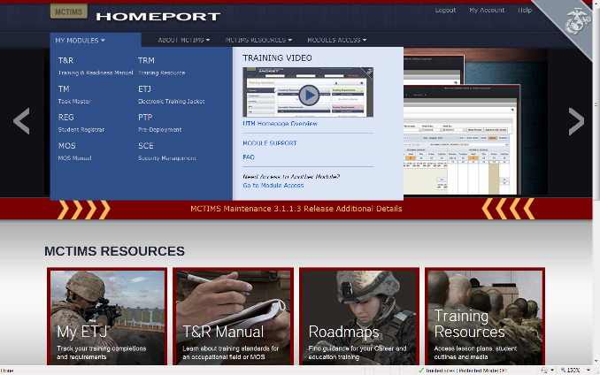
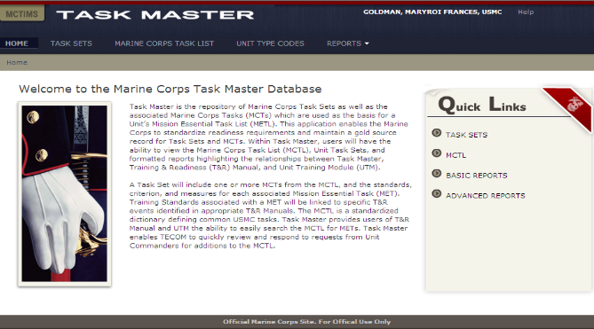
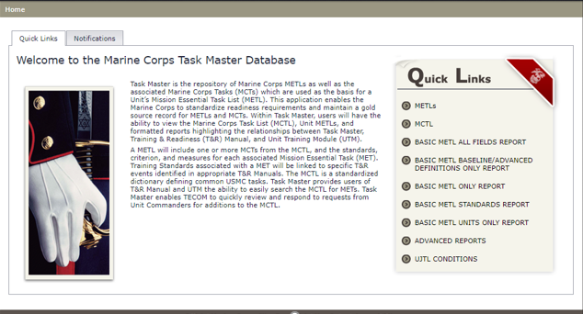
MCTIMS Task Master
ADS for MCTL / METs / METLs
MY MODULES
TM
TASK MASTER
38

Slide 39
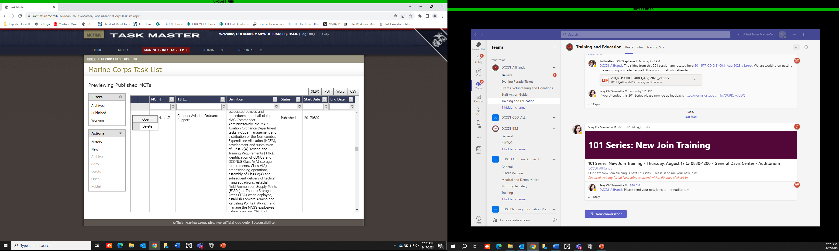
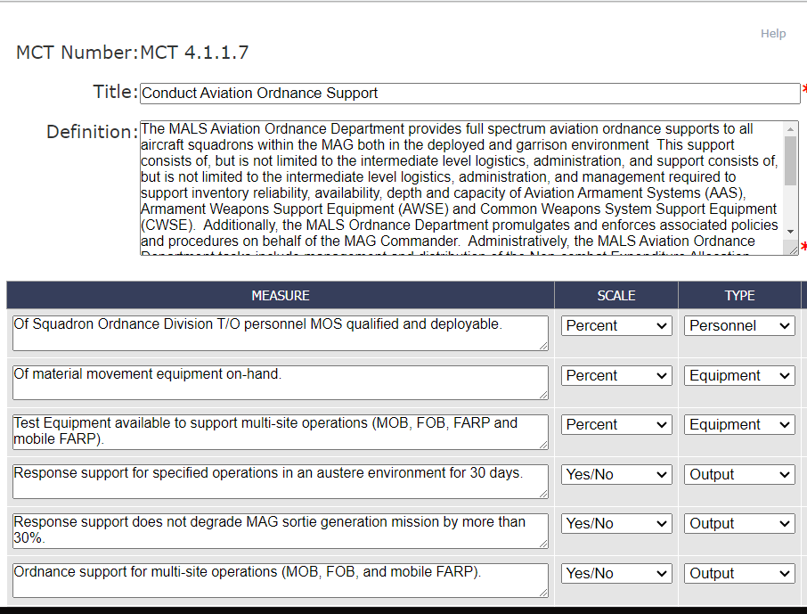
MCTIMS Task Master
Marine Corps Task List

Slide 40
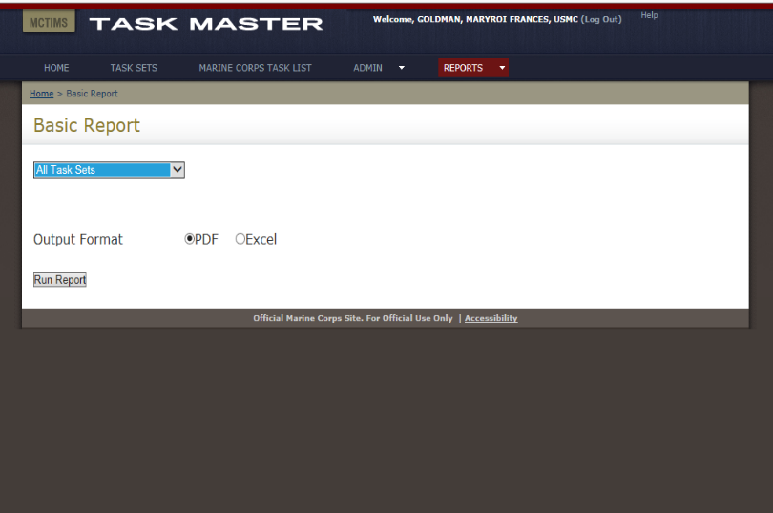
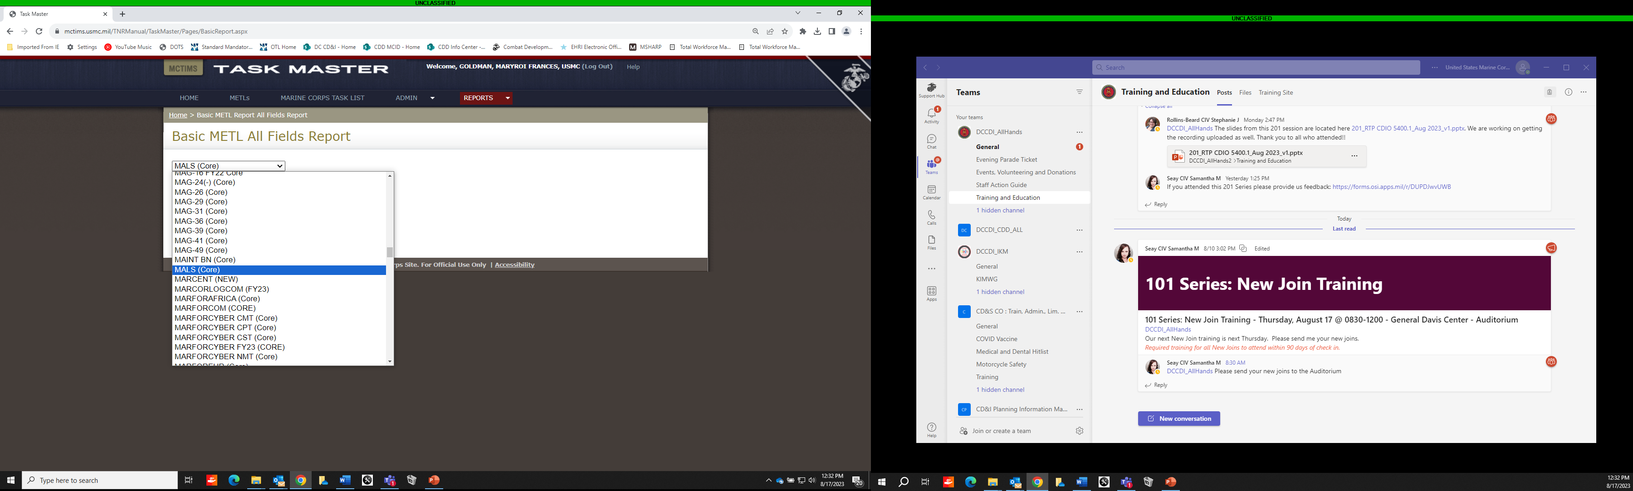
MCTIMS Task Master
Task Sets/METLs / Community Reports

Slide 41
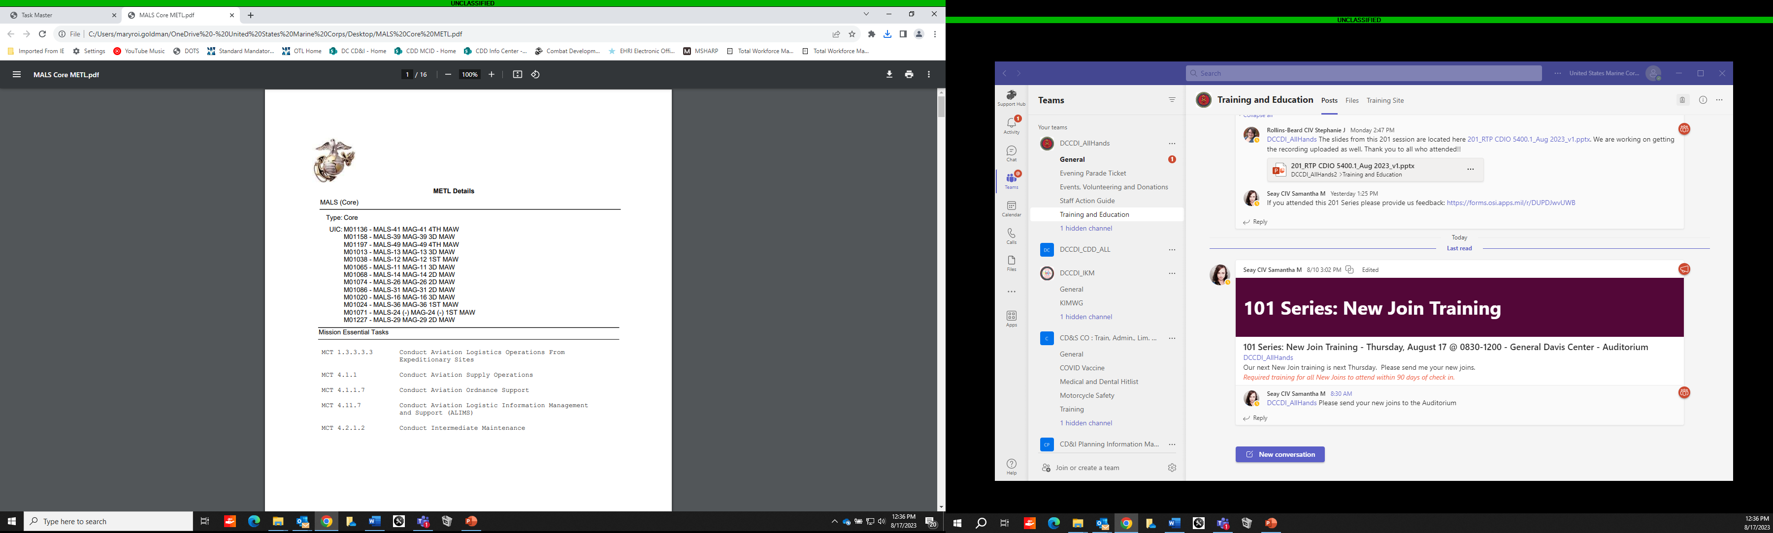

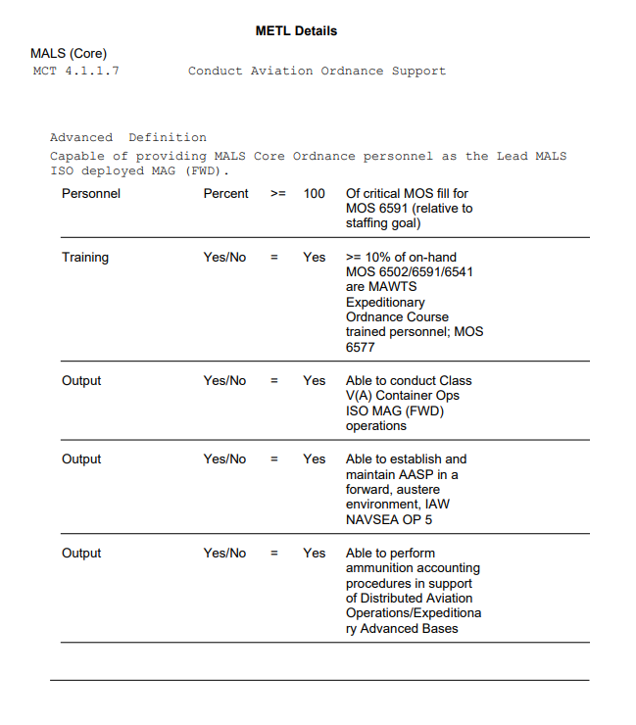
METL Reports
Org UIC / METL / MET Summary:
Baseline/Advanced Capability Statement,
Personnel, Equipment, Training and Output

Slide 42
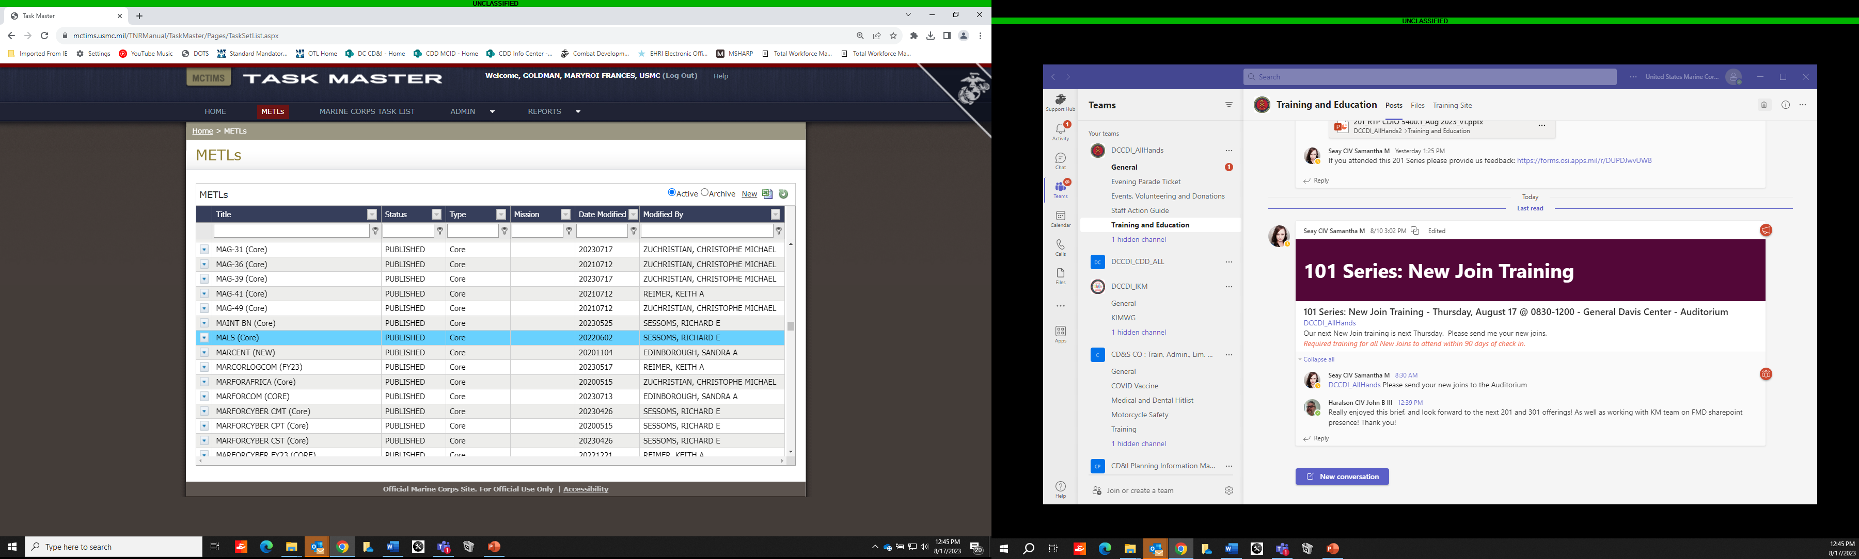
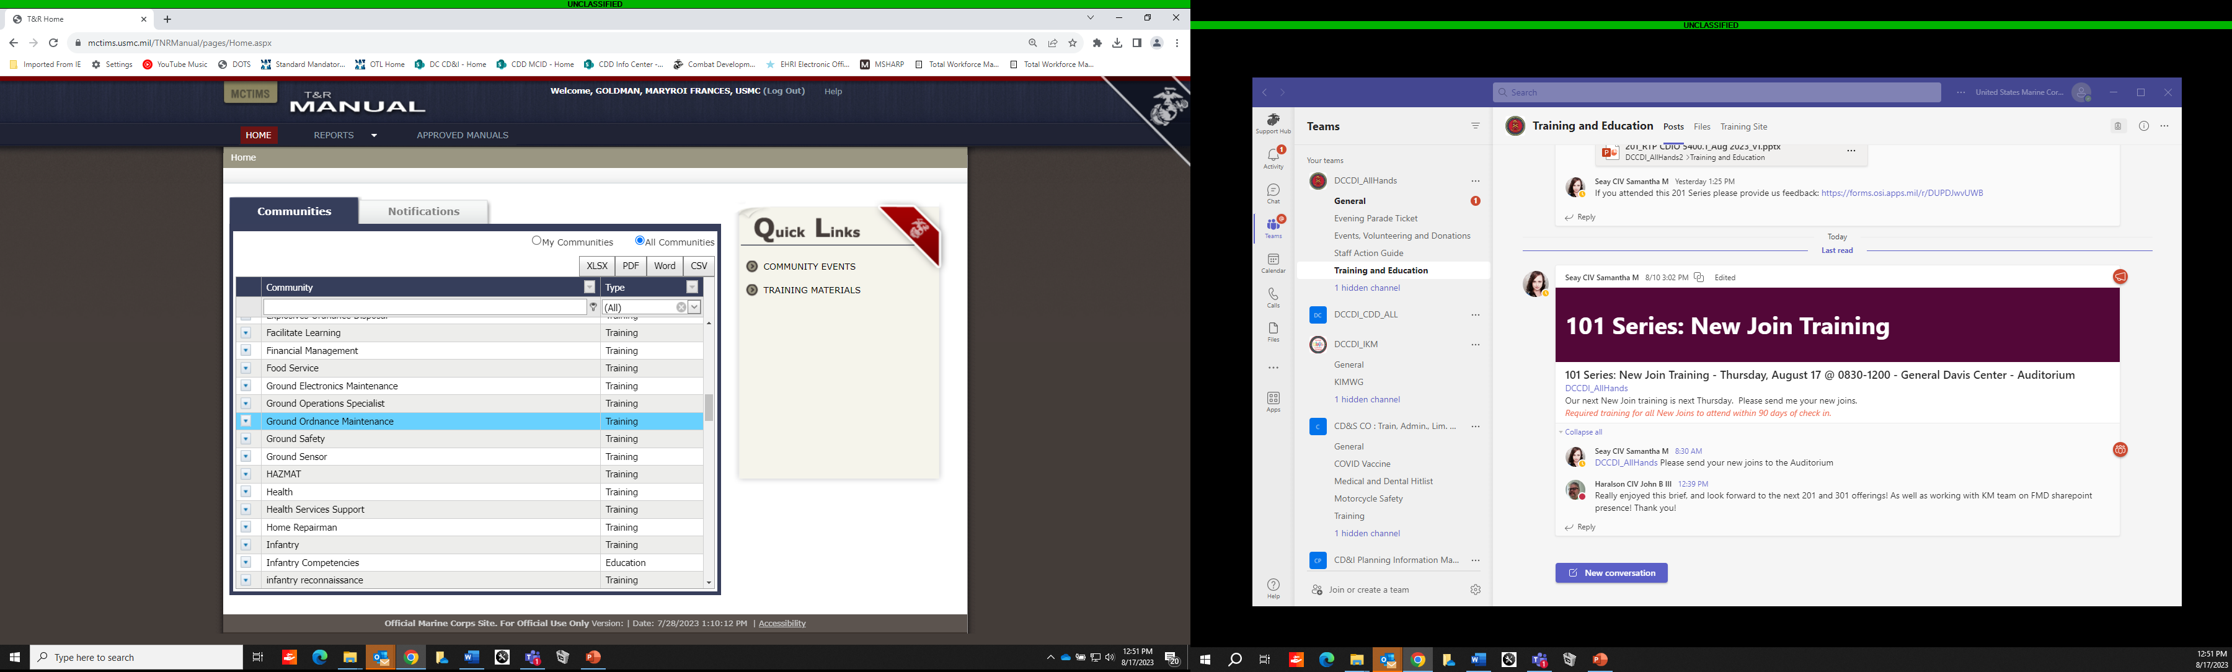
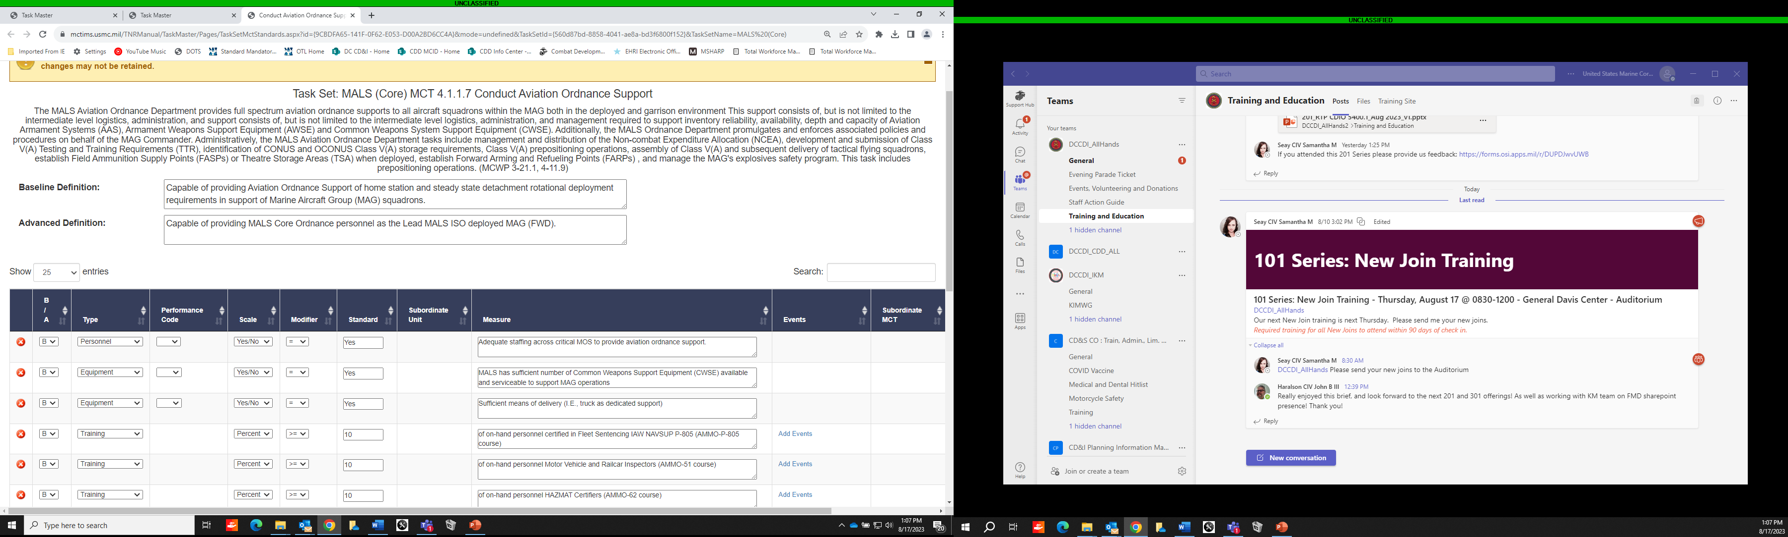
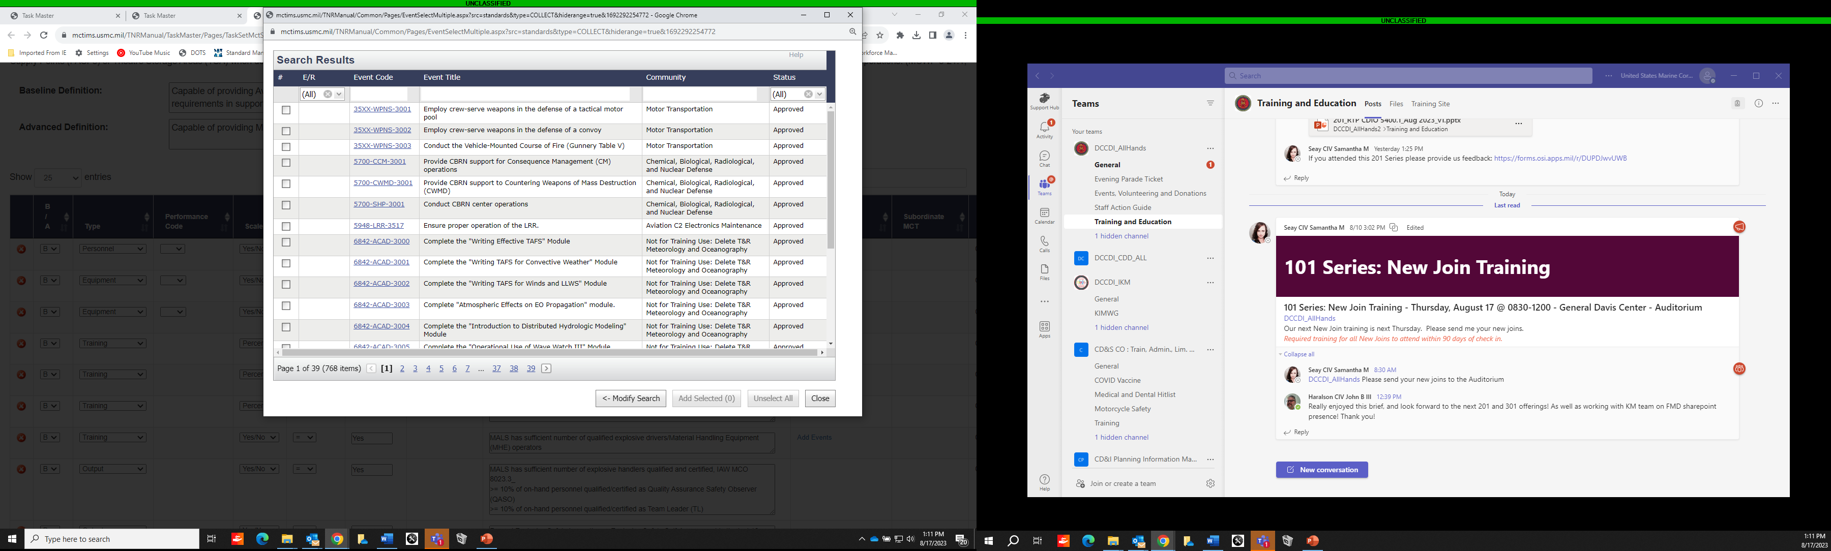
MCTIMS Task Master
Task Sets/METLs, T&R Manual,
Community Training Events

Slide 43
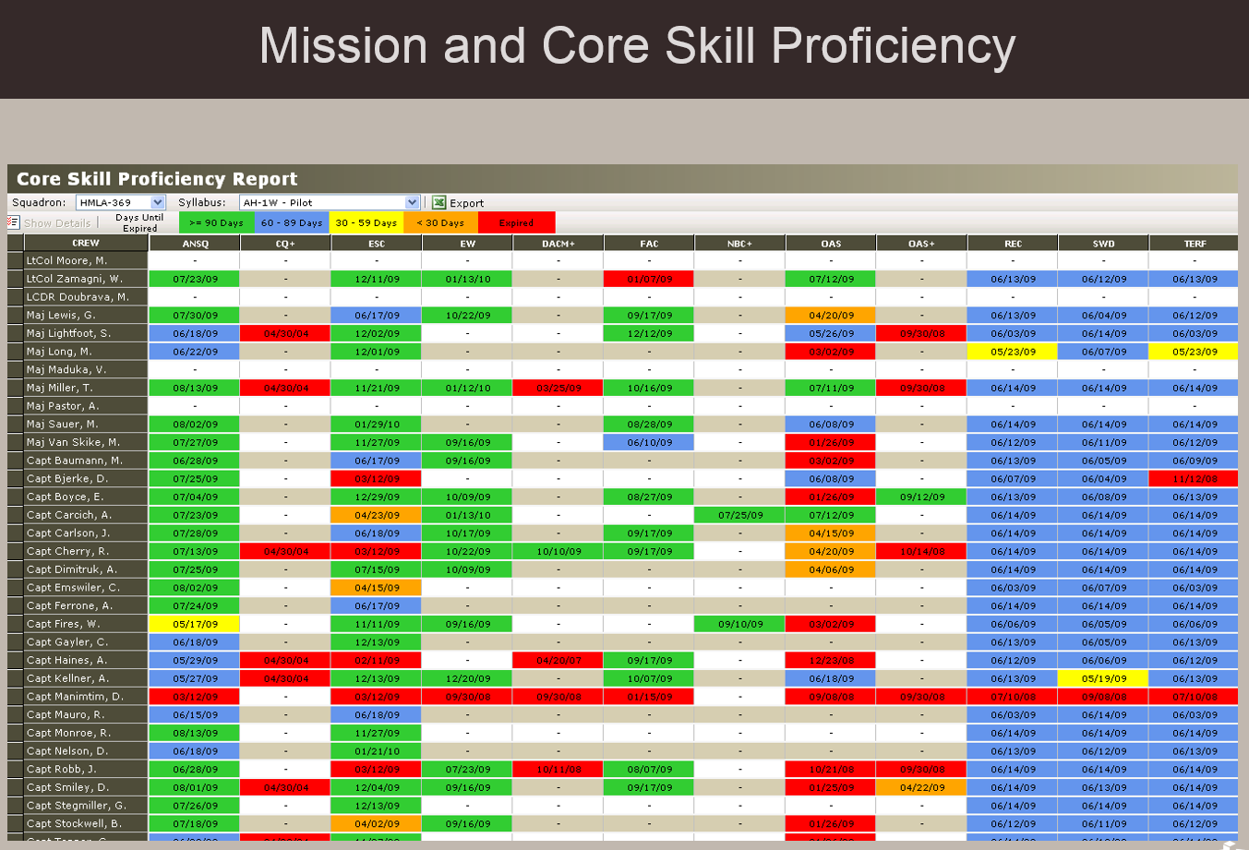
MSHARP
USN/TECOM Aviation Training & Readiness System
MSHARP Modules:
Flight Logger
Aircrew Logbook
Individual Qualifications (Admin)
Individual Qualifications (Flight)
Individual Event Proficiencies
METs/Mission and Core Skill Proficiency
SBTP / Formation
Simulator Management
Simulator Scheduling
Simulator Utilization
Unit Flight Scheduling
Resource Availability
Sortie Based Training/Flight Hour Program
Flt Leadership
TMR Codes
T&R Codes
Approaches
Landings
Ranges
Ordnance
FAC(A) Controls
Passengers / Cargo
Hoist / Fuel Reports

Slide 44
Critical MOS – DRRS P Levels
DRRS calculates the P-Level of a reporting unit based on the lower of two levels:
  The overall personnel strength based on T/O. For this calculation to yield a Personnel Strength of P-2, the unit must have 80% of personnel available (not detached) and deployable.
  The critical MOS fill, based on selected MOS. A script will look for BMOS and PMOS matches for each BIC on the T/O, generating a requirement for each selected MOS. The total fills (available/deployable) against these requirements, divided by the total requirements, yields a percentage. For this calculation to yield a P-2, the unit must have 75%. At least three MOS must be designated.
If every MOS is critical, the two calculated percentages will be equal, and the critical MOS will never be a factor because 80% is a tougher requirement than 75%. We try to avoid the added work of reporting critical MOS when doing so does not improve value of the report.
If the critical MOS list includes a high volume MOS as well as several lower density MOS, the lower density MOS will not matter.
  Example: A unit could select a High Density MOS (30 x 0311), as well as two lower density MOS (1x 0302 and 1x0369).
  If the 30 x 0311 are filled, the unit could be 30 of 32 (94%) even if neither of the other two are filled.
  An excess in 0311 (32 of 30 x 0311 billets filled), can put the unit at 100% critical MOS fill with the other critical MOS entirely gapped.
No automatic requirement to designate the "identity" MOS for a unit as critical. No requirement to designate 0311 Infantrymen for an Infantry Battalion. [Strongly discouraged for reasons noted above.]
As a result, two best practices apply:
  1) Do NOT select a set of critical MOS that in total would represent over 50% of the unit.
  2) Do NOT select any critical MOS that represents a high volume in comparison to the other selected MOS.
Exceptions:
  1) Some units only have 3 MOS. In this case, they must select all 3.
  2) Some units have a higher density MOS with a historically low level of fill - a new MOS, a problem MOS, etc., and other MOS don't matter or are not expected to be an issue. In this case it may be worth selecting the MOS in order to focus on the main issue.
BLUF: Wherever possible, use the Critical MOS list to highlight low density MOS that would be lost in the aggregate calculation but generate disproportionate effects if not filled.

